Slide 1

ŞEYMA TANER
GEARMAN MONITOR
Ankara University
Computer Engineering
DevOps

Slide 2

Background Job server
Job
Job
Client
Worker
For example: Export Data operation.
Gathering all forms, submissions and upload files of a user

Slide 3




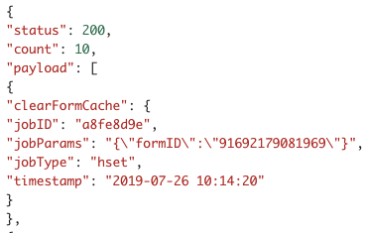
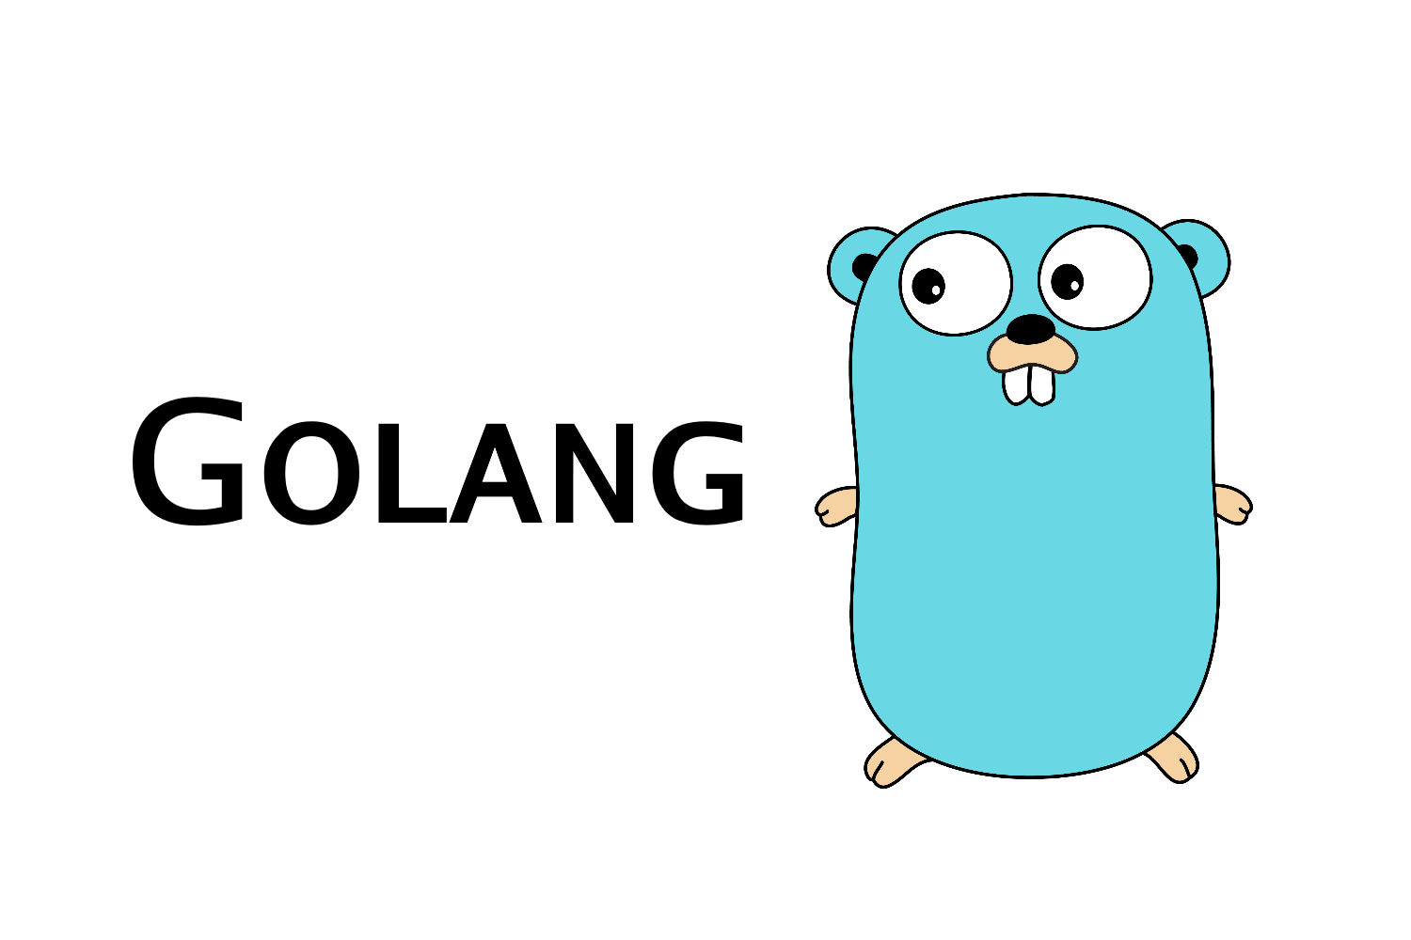
Job Insert/delete
Background Job server
connect
Job
Job
Client
Worker
Connect
Psubscribe
(*)
Http Response
Http Request

Slide 4
Properities
To learn parameters of Gearman jobs for Security and find whether any structural changes
To analyze Gearman jobs using calculate start and finish time of jobs
To keep track of failed jobs according to parameters and date

